Slide 1
Behind the Hooks
:Evasion and Defense
Monika Sahu
26-July-2025-Sat
OWASP Mumbai Online Meetup

Slide 2
About Me
Security Researcher @ QuickHeal
Working on NGAV
ToI
Contents are only for educational purpose.

Slide 3
What is it?
Why are we talking this?
Show some use cases?

Slide 4
What is hooking?
What is Syscall
What is it?

Slide 5

Method (parameters) {
Jump (to hook)
Code1 Code2 return value }
Hook( )
{
…. }

Slide 6
Hooking vs MITM
Types
IRL common examples

Slide 7
Hooking VS MITM

Slide 8
TYPES
Inline
IAT
EAT
Syscall

Slide 9
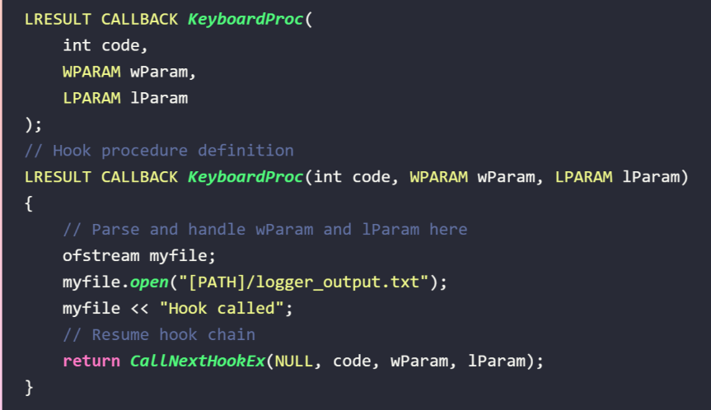
IRL common examples

Slide 10
Offensive Approach
Enables attackers to manipulate legitimate processes, bypass defenses, and hide malicious activities.

Slide 11
Purpose:
Credentials Theft: Hooking LogonUserW, GetAsyncKeyState
Stealth & Evasion: EnumProcesses , NtQueryDirectoryFile
Bypassing Security: OpenProcess, NtQuerySystemInformation,
Process Injection & Persistence: CreateRemoteThread , WriteProcessMemory

Slide 12
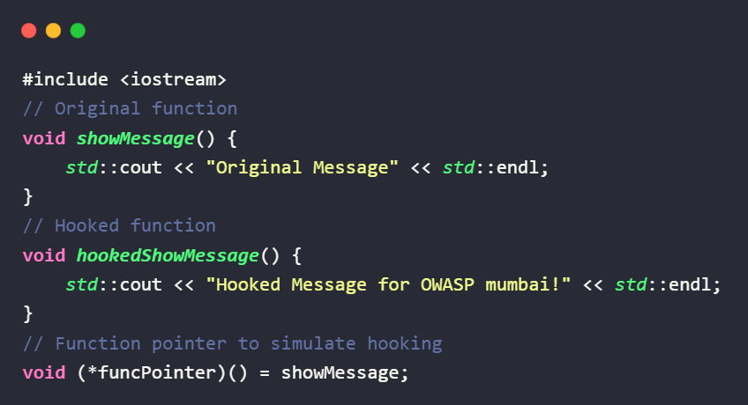
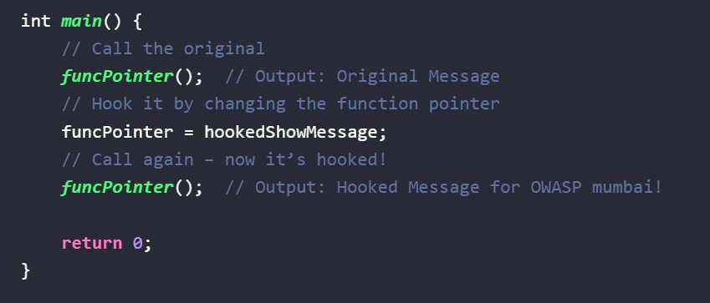

Slide 13
Defensive Approach
Used by security tools, EDRs, AVs and sandboxes to monitor, log or block suspicious behavior by intercepting API calls or system functions — without modifying their core logic.

Slide 14
Purpose:
Behavior Monitoring : By hooking CreateProcessW, WriteFile, or RegSetValueExW.
Detection & Logging: Security software hooks functions.
Policy Enforcement: Hooked functions can be modified to block execution if the behavior violates security policies.
Memory and File Scanning: Hooked calls like ReadProcessMemory or CreateFile help detect malware’s attempt to access sensitive content.

Slide 15
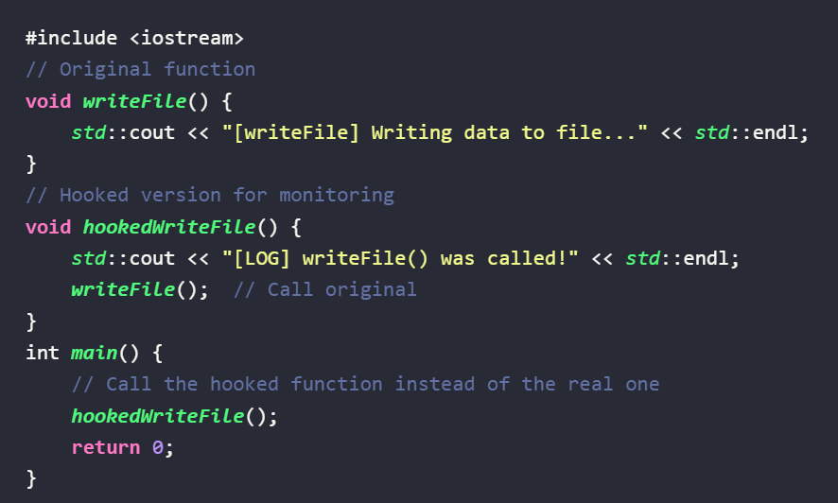
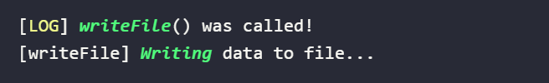

Slide 16
Challenges & Conclusion

Slide 17
Thankyou

